Slide 1
AePW-3 Telecon
Oct 10, 2019

Slide 2
Agenda: October 10, 2019
Hypersonics Working Group
Large Deformation Working Group
Notes:
High angle of attack Working Group: Telecon to be held next Thursday Oct 17 at 11 am
Inquiry made to AIAA-Applied Aero TC regarding possibility of discussion sessions at 2020 SciTech (Jan) and Aviation (June) conferences. No information yet.
Website landing page is public facing now https://nescacademy.nasa.gov/workshops/AePW3/public/
Polls & Surveys
Doodle poll
https://doodle.com/poll/gbxvw3u4ispqetz5
Survey to scope and document interest and participation plans
High Fidelity CFD workshop discussion planned for next telecon
Next telecon Nov 7

Slide 3
Hypersonics FSI Working Group
Telecon held on 10/04/2019.
Attendees
Duke University: Prof. Earl Dowell, Kai Bastos, Kevin McHugh
USAFA: Adam Jirasek
ATA Engineering: Eric Blades
identified 4 potential classes of problems
Control surface flutter
Skin panel flutter
Shock-boundary layer interaction driving a panel response
???
Control surface flutter, represented by a panel with free edges, seemed to be the most important in terms of mission success.
Discussion regarding the goal of the workshop and how we identify a relevant workshop problem: select a challenging problem that can be solved using state-of-the-art methodologies and compare results to identify best practices, etc. or select one that pushes the SOA to identify deficiencies, shortcomings, and areas we need to improve. No consensus was reached.
Discussion on upcoming or recent high-speed experiments that could potentially be used as the reference data for the workshop.
The recent aerothermoelastic test conducted by the AFRL Structural Sciences Center at AEDC VKF C using a thin-panel is going to be limited distribution and thus not a candidate for an open workshop like AePW3.
Experiments being conducted by Stuart Laurence (Univ. of Maryland), Andrew Neely (Univ. of New South Wales), DLR, Katya Casper (Sandia), and others were also mentioned, but unfortunately none of the experimentalists were able to participate.
Follow-on discussion the next few weeks. No date has been set yet.

Slide 4
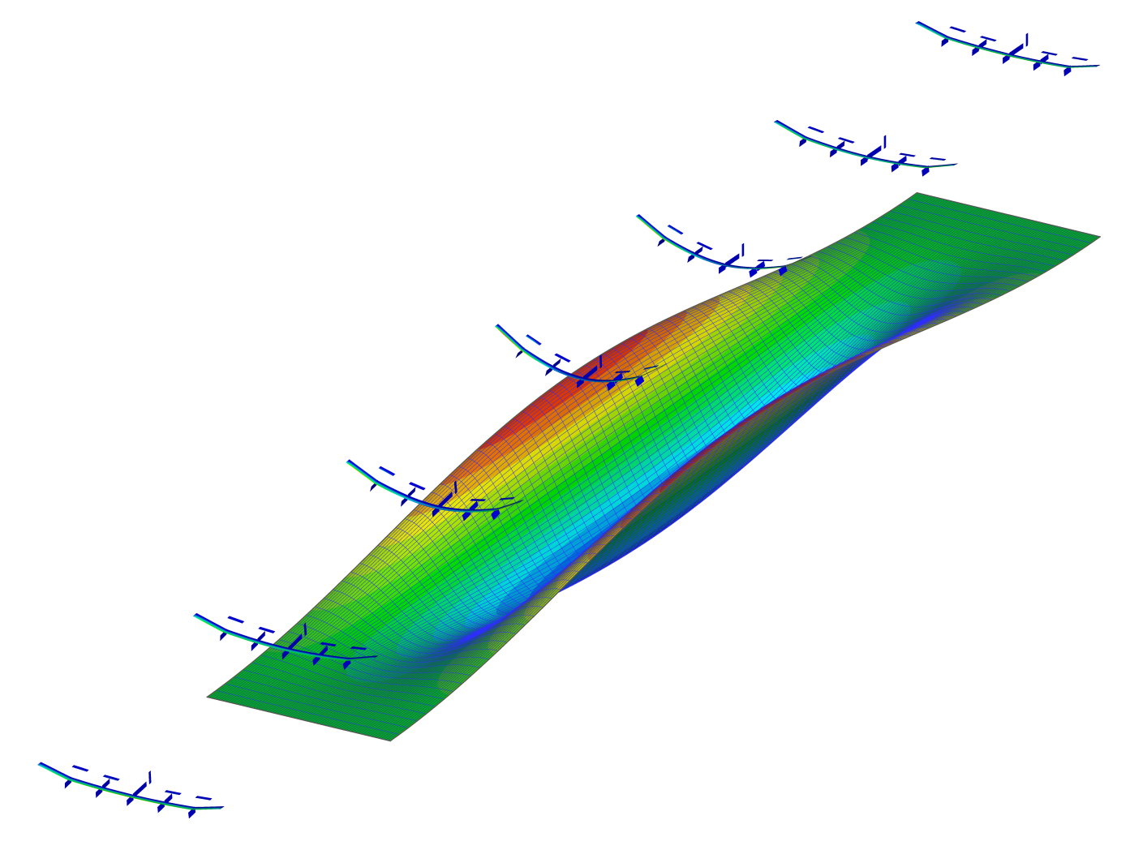
Moving Forward with the Aeroelastic Prediction Workshop 3
Large Deflection Group
Notes for AePW-3 Telecon, October 10, 2019

Slide 5
Large Deflection Group: Members (mailing list as of October 2019)
Member | Facility
Earl Dowell | Duke University
Kevin McHugh | Duke University
Maxim Freydin | Duke University
Kai Kruger Bastos | Duke University
Daniella Raveh | Technion
Moti Karpel | Technion
Arik Drachinsky | Technion
Rafael Palacios | Imperial College
Huub Timmermans | NLR
Jonathan Cooper | University of Bristol
Carlos Cesnik | University of Michigan
Roeland de Breuker | TU Delft
Jurij Sodja | TU Delft
Markus Zimmer | DLR
Johannes Dillinger | DLR
Markus Ritter | DLR

Slide 6
Large Deflection Group: Organization
A Large Deflection Group was launched within the community interested in a third Aeroelastic Prediction Workshop (AePW-3)
This group will primarily focus on nonlinear aeroelasticity regarding large (nonlinear) structural deflections and their impact on the system
The first Telecon of this group was held on September 25th:
Motivations, topics, ideas, etc. were discussed and some test cases were presented
The test cases from Duke University and Technion gained the most interest (see below)
In the meanwhile, other configurations and a number of research topics centered around them were proposed and discussed via email
The following slides show the currently most relevant experimental and simulation test cases

Slide 7
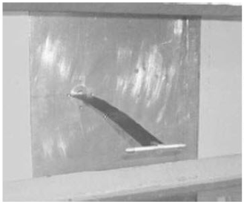
Duke University Aeroelastic Models
Goals:
Provide experimental data set to evaluate new nonlinear theoretical aeroelastic theories and computation methods
Provide insights into nonlinear aeroelastic phenomena, such as flutter, LCO, and gust response
High AR Wing Model:
Made from steal spar and aluminum pieces/ribs (NACA 0012) with wood filling for aero shape
Span 0.4508m, chord 0.0508m
Slender body with masses to adjust torsional inertia to reduce natural torsional frequency
Tests:
Correlation studies for static aeroelastic response, flutter and LCO oscillations
AePW benefits:
Simple structural model
Static and dynamic experimental data including LCOs
Paper/Info: Tang and Dowell, Experimental Aeroelastic Models Design and Wind Tunnel Testing for Correlation with New Theory, Aerospace 2016

Slide 8
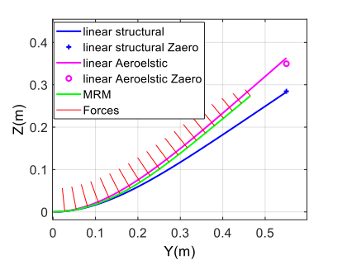
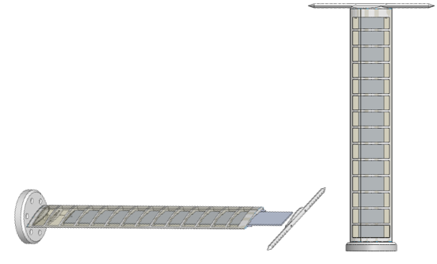
Technion Highly Flexible Wing Experimental Benchmark (in process)
Goals:
Generate a benchmark for static and dynamic (flutter) aeroelasticity of a very flexible wing. Will be used for validation of computational models and investigation of nonlinear aeroelastic phenomena.
Gain experience with novel aeroelastic measurement techniques (optical fibers and motion tracking camera system)
Model:
Geometry:
Chord - 100 mm, span - 550 mm
Main spar: 550 X 60 X 2.5 mm, at the center-chord
Airfoil - NACA0018, wing-tip rod for attaching weights
Materials:
Main spar - Aluminum 7075
Chassis - Nylon, PA12, 3D-printed
Cover - Foil (Oralight, or the like)
AePW benefits:
Simple, low-cost design
Can be shared and tested in several wind-tunnels
FEM available (Ansys)
Paper/Info: Avin et al., Design of an Experimental Benchmark of a Highly Flexible Wing, IACAS

Slide 9
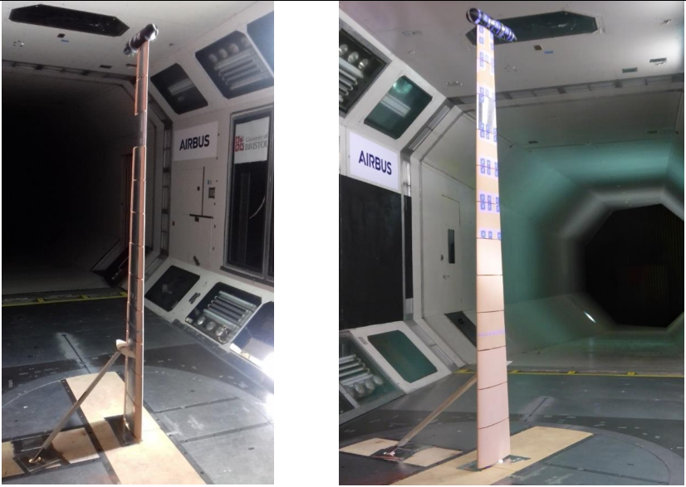
University of Bristol High Aspect Ratio Wing Model (AWI-HARW)
Goals:
Explore static and dynamic aeroelastic behavior below flutter, but with LCOs due to geometric and aerodynamic nonlinearities
Model:
Semi-span = 2.4m, AR = 20, root chord = 320mm, taper ratio = 0.5
Aluminum alloy spar with foam sections and covering for aero shape
Data sets:
WT balance readings
deflections from 3D Cameras
strains and accelerations
static pressures on one chordwise section
unsteady pressures on one chordwise section
Tests:
Structural tests (including GVT)
Static aeroelastic tests (max. tip deflection ≈ 25 % (w.r.t semi-span)
Harmonic oscillations, push release
Dynamic response with LCOs (in-plane bending and flow separation)
Structural model/FEM?
Paper/Info: Cooper et al., Wind Tunnel Testing of a High Aspect Ratio Wing Model, IFASD 2019

Slide 10
Interests and way forward
Regarding these three test cases, we are interested in the investigation of several topics:
Analysis of large static deflections (comparison of different theories and methods)
Structural properties under preload due to large static deflection (changes in modal properties)
Limits of linear methods (both structure and aero)
Stability of the system about statically deformed aeroelastic shape (flutter, LCO)
Hysteresis in LCO
Impacts of nonlinear inertia effects on flutter/LCO (coupled in-plane and torsional motions at large deflections)
Impact of aerodynamic nonlinearities (stall and flow separation at high AoA, low Reynolds numbers, necessity of high fidelity methods such as URANS)
Interaction of aerodynamic and structural nonlinearities
So far, most of us agreed to contribute to the Technion Benchmark Wing and the UoB AWI-HARW
DLR and TU Delft offered to support collaborative experiments of the Technion Wing by testing this model in their wind tunnel (TU Delft would also do a GVT)
There is also interest in flight dynamics of very flexible A/C, but this seems appropriate after the wing-only tests
We will have another Telecon in the Large Deflection Group to decide upon the test cases we want to use and then develop a sequence of reasonable investigations

Slide 11
Moving Forward with the Aeroelastic Prediction Workshop 3
Telecon Notes
Sept 9, 2019

Slide 12
Notes from Sept 12 2019 Telecon (Page 1/3)
Next telecon will be on Oct 10 (rather than on Oct 3 which is the first Thursday) in recognition of German Unity (or Unification?) Day
Webex: when the webex link comes up, there is an incorrect telecon number that is displayed.
Reviewed the survey. 9 parties had responded. Discussion of expanding the survey. Jens added more categories on the fly. Bret reminded us that he was taking the lead on the google poll which would maybe help us to identify what product(s) do each of us want to get out of a workshop? Whereas the existing (and complementary) poll is more focused on what physics do we care about. Should the poll be expanded or does the current one make it easy to observe trends and extract data?
Website landing page isn’t public-facing yet, and it only contains telecon information currently. Please try to access it again next week.

Slide 13
Notes from Sept 12, 2019, (page 2/3)
Steve Massey reviewed the experimental test cases that have been sent to him to date. (Steve’s slides are included in these slides)
High fidelity CFD workshop was mentioned and briefly discussed. We will ask Steve Wood, one of the organizers of that workshop, to discuss that workshop including planned test cases. Multi-purpose discussion: technical synergies, organizational aspects, possible participation
Based on initial survey feedback, formed 3 ad hoc exploratory working groups.

Slide 14
Notes from Sept 12, 2019 Telecon (Page 3/3)
Working groups- ad hoc exploratory phase groups?
Large Deformation Working Group tentative membership (Carlos to coordinate initial email): Carlos Cesnik, Markus Ritter, Daniella Raveh, Jonathan Cooper, Earl Dowell, Kevin McHugh, Kai Bastos
Hypersonics (Eric Blades to coordinate initial email): Eric Blades, Adam Jirasek, Kevin McHugh, Kai Bastos, Earl Dowell) Note that there may be interest from the High Fidelity CFD group.
High angle of attack (Jen Heeg to coordinate initial email): Jen Heeg, and all those who have taken the survey except Markus (who is the only one who didn’t select this as an area of interest)
Expectations from these groups
None?
Item on the agenda of the next telecon to see if they have exceeded expectations
Exchange emails or have discussions to try and find common ground, objectives, tests cases, other good things

Slide 15
Survey progress & path forward
https://doodle.com/poll/gbxvw3u4ispqetz5
Suggest defining a suite of cases as shown for the high fidelity CFD workshop
Possible collaboration and participation in high fidelity CFD workshop

Slide 16
Website progress
https://nescacademy-s.larc.nasa.gov/workshops/AePW3/public/

Slide 17
Collaboration format
Objective of workshops: Collaborate in an effective manner, getting the most return for time investment.
Prior workshops were patterned after Drag Prediction Workshop. This is not a requirement, but rather has been a choice. We are free to make a different choice.
Workshop and workshop process?
Collaborative workspace that can naturally leads to a workshop?

Slide 18
Objectives of the Aeroelastic Prediction Workshop
Assess the goodness of computational tools for predicting aeroelastic response, including flutter
Understand why our tools don’t always produce successful predictions
Which aspects of the physics are we falling short of predicting correctly?
What about our methods causes us to fall short of successful predictions?
Establish uncertainty bounds for computational results
Establish best practices for using tools
Explicitly illustrate the specific needs for validation experimentation- i.e. why what we have isn’t good enough
Establish community for leveraging experiences and processes

Slide 19
Survey of unsteady aerodynamic experimental data sets
Send technical reference papers on data sets acquired since 2005
Unsteady aerodynamics
Flutter
Buffet
LCO
Send to steven.j.massey@nasa.gov

